Slide 1
B.S.B Presentation 2015
Nathan Giles – Nicholas and Harris

Slide 2
Introduction
Starting Out in the Baking Industry.
National Bakery School.
Life After Studying:
Mr. Bagels Ltd
Rich Products
Nicholas & Harris
Rising Star Award.
My Advice for Students.

Slide 3
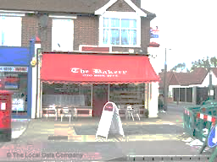
Starting out in the Baking Industry
Started baking in an in-store bakery at Sainsbury’s New Cross Gate.
I was finding that I really enjoyed baking and decided I would look for a bakers apprenticeship.
Started working at The Bakery, Pickford Lane, Bexleyheath.

Slide 4
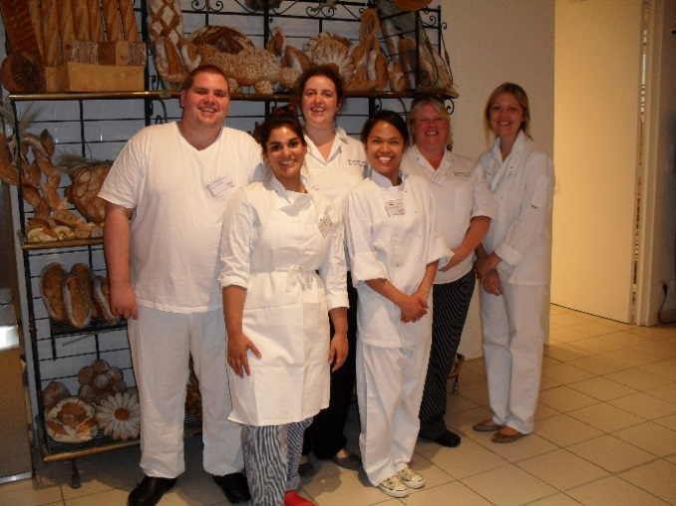
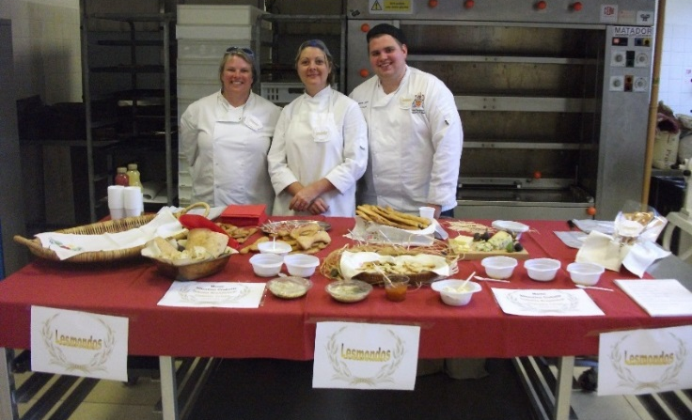
National Bakery School:
I attended the National Bakery School for my studies
Courses I took were:
City Guilds Level II – Food Manufacturing
FdSc Baking Technology Management
BSc Baking Technology Management
Final year I was offered the chance to study for an MSc via a KTC with Mr. Bagels Ltd and London South Bank University.

Slide 5
Life after Studying – Mr. Bagels Ltd:
Work at Mr. Bagels Ltd:
Development of bagels for retailers in UK and across Main Europe.

Slide 6
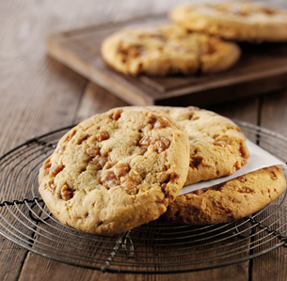
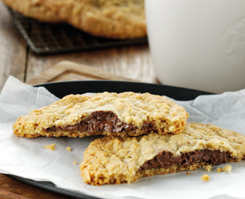
Rich Products:
Moved from Woolwich, South East London to Worcester for a role as a Development Technologist with Rich Products.
Worked at the Hartlebury site making cookies, in frozen pucks and freezer thaw.

Slide 7
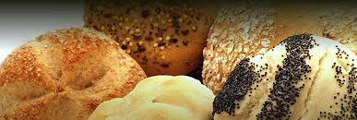
Nicholas & Harris:
Currently working on Branded Range of Products.
Work as a New Product Development Technologist.
Food Service

Slide 8
Nicholas & Harris:
Support from my colleagues at N&H.
Also support from them on the night as the booked a table.
Business is growing and expanding, investing in personnel and resources.
Future for N&H:
Over the next financial year the business is investing £2.5million in capital into the bakery.
Building of a new NPD Test Bakery.

Slide 9
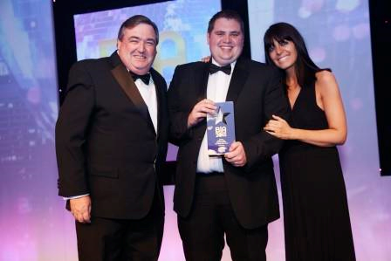
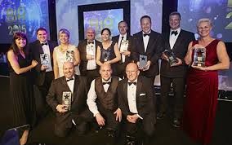
Rising Star Award:
Why I chose to enter the award:
To become know to a wider audience, to let people know what I am about and what I want to achieve in the industry.
Personnel acknowledgement of what I have achieved so far.

Slide 10
Advice for the Students:
Ask questions and also ask advice.
Help students that are in the years below you.
Try and attend as many collage trips or sponsored trips as possible.
Always listen to the feedback given even if it hard to digest sometimes.
Most importantly enjoy the work you do.

Slide 11
Thank you for listening
Are there any questions?

