Slide 1
Tackling the issues of reducing the sugar in cakes
Gary Tucker
Baking and Cereal Processing Department
Campden BRI

Slide 2
Content
Update on sugar issues in the UK – the challenges facing the industry
Functions of sugar and the alternatives
The future

Slide 3
Update on sugar issues in UK
UK government published draft legislation for a tax on sugar-sweetened drinks, to begin from April 2018.
Ministers hope it will help tackle the obesity problem.
Two bands; >5g of sugar per 100ml and a higher band for drinks with >8g per 100ml (amounts to an extra 6p on a regular can of Fanta and Sprite, and 8p on Coca-Cola, Pepsi and Irn-Bru).
Many companies have already begun cutting the amount of sugar in their drinks.
The government has said it expects the levy to raise £520m in the first year.

Slide 4
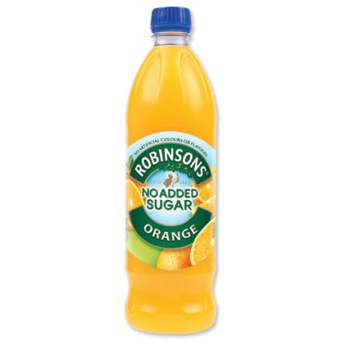
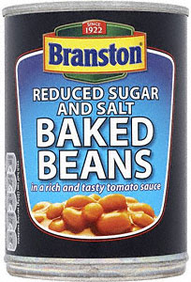
Sugar claims
Low sugar
≤ 5.0g/100g (solids)
≤ 2.5g/100ml (liquids)
Sugar-free
≤ 0.5g/100g or 100ml
With no added sugars
Contains naturally occurring sugars
Reduced sugar
At least 30% less than a comparable product

Slide 5
What’s next?
Other high sugar products will follow such as bakery products ‘......they are high in free sugars but offer little nutritional value’.
20% reduction by 2020 (PHE, 30 March 2018)
Reformulating
Reducing portion size
Shifting consumer purchasing habits
Includes all sugars whether added or natural
Without increasing saturated fat or calories

Slide 6
Sugar Reduction: Achieving the 20%
Recognise some businesses will need technological solutions to achieve sugar reductions, but encourage industry to consider simple solutions first.
Data from the National Diet and Nutrition Survey showed foods that contributed most sugar to children’s intakes: biscuits; breakfast cereals; cakes; chocolate confectionery; ice cream, lollies and sorbets; morning goods (e.g. pastries, buns and waffles); puddings (including pies and tarts); sweet confectionery; sweet spreads and sauces; and yogurt and fromage frais.

Slide 7
How is sugar content measured?
Regulation (EU) No 1169/2011 FIC defines sugars for labeling purposes as the sum of all monosaccharides and disaccharides present in food, but excludes polyols
Monosaccharides – glucose, fructose, galactose
Disaccharides – maltose, sucrose, lactose
Therefore no higher sugars such as maltotriose

Slide 8
Analytical methods
Most common is HPLC – gives a profile – requires capital investment and analytical skill
Enzymatic – specific to each sugar, analytical dexterity required
Titration of reducing sugars (Lane Eynon and Luff Schoorl) - gives total sugars after inversion of sucrose with acid
Brix refractometry – use with caution, measures dissolved solids not specifically sugars, is matrix dependant

Slide 9
The Functionality of sugar (in cakes)
Flavour
Bulking agent
Stabilises and controls batter viscosity
Influences the setting temperature
Colour (Caramelisation and Maillard)
Humectant (preservative)
Softens the texture

Slide 10
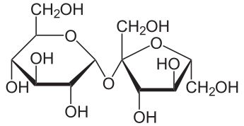
1. Role in flavour (sweetness)
Sucrose is often referred to as sugar
Sugars give sweetness (obvious statement but important) - industrial cakes contain a lot of sugar so sweetness is less important
Sweetness can mask bitterness
Natural sugars are blends that give complex flavours (e.g. Honey)
Sucrose
C₁₂H₂₂O₁₁

Slide 11
‘Industrial’ cakes are very sweet
Typical bakery products per 100g (%)
 | Pound cake | Wholemeal bread | Madeira cake
Protein | 6.0 | 10.0 | 5.3
Carbohydrate | 49.0 | 37.8 | 56.4
Sugars | 28.0 | 4.1 | 34.2
Fat | 20.0 | 1.8 | 15.2
Saturates | 12.0 | 0.4 | 9.2
Fibre | 0.5 | 6.8 | 1.1
Salt | 1.0 | 0.9 | 0.7

Slide 12
Alternative sugars (sweetness)
Name | Sweetness
Lactose | 0.27
Lactitol | 0.4
Sorbitol | 0.6
Erythritol | 0.81
Sucrose | 1.00 (reference)
Fructose | 1.70
Stevia | 40 – 300
Aspartame | 180 – 250
Saccharin | 300 – 675
Sucralose | 300 - 1100
Nutrasweet | 7,000 – 13,000
High fructose corn syrup

Slide 13
High intensity regions
Tried with salt reduction – topical additions, layers, inclusions
Sugar crystals on top will work if shelf life is short – will dissolve with longer SL retailer cakes
Fillings and icings can contain higher sugar or high intensity alternatives – but caution with water migration if a_{w} is not matched

Slide 14
Complex flavours; sour dough
Numerous flavour compounds generated during bacterial and yeast fermentation
Changes flavour profile so sweetness less relevant
Some sugar generation during fermentation
More acceptable to adults than children

Slide 15
2. Role as a bulking agent
Sugars take up volume in a product
Have to replace this when formulating low sugar products
e.g. 30% reduced sugar cake would be about 30% smaller
Polyols, fibres (inulin) offer bulking
Caution with sugar analysis method – can give falsely high values

Slide 16
3. Role in stabilising and controlling batter viscosity
Sucrose dissolves in the aqueous phase of a batter – controls batter viscosity
Stabilises the batter by preventing air bubbles from coalescing or rising, and suspending starch granules
Hydrocolloids, gums, gels used to increase viscosity

Slide 17
4. Role in influencing the setting temperature
Competition for water raises the starch gelatinisation temperature by affecting hydration
Allows longer for the gases to expand and contributes to higher volume and softer texture
Helps to create soft, ‘almost’ baked textures with muffins and brownies
Other humectants do a similar job

Slide 18
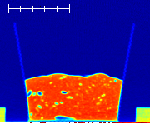
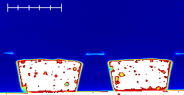
Relative absorbance
High sugar cake
1.0
Water
0.9
0.8
0.7
0.6
0.5
0.4
0.3
0.2
Muffins
0.1
0.0
Air

Slide 19
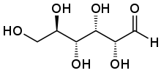
5. Role in colour development
Caramelisation >150°C, sugars break down to highly reactive compounds , these polymerise into dark brown substances we know as caramel.
Maillard Reaction >105°C, reaction between reducing sugars and amino acids, forming highly reactive products that polymerise into yellow-brown compounds
Reducing form of glucose

Slide 20
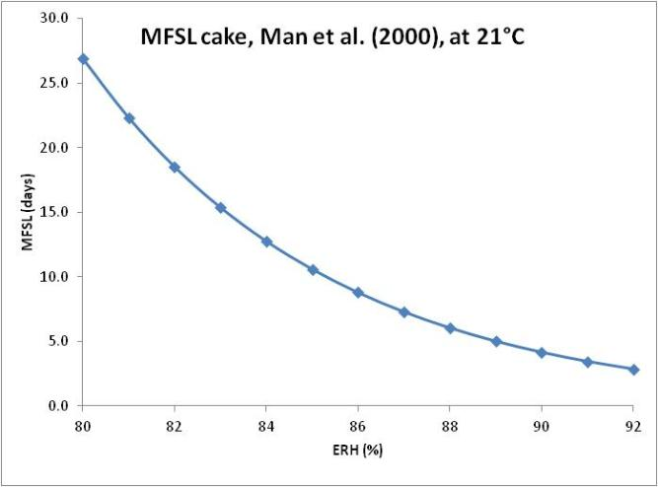
6. Role as an humectant
Sucrose binds water, preventing microorganisms using it for metabolism
Reduces the Water Activity (a_{w}) and slows growth
Extends the mould-free shelf life (MFSL) of bakery products
Options; kill or slow mould growth

Slide 21
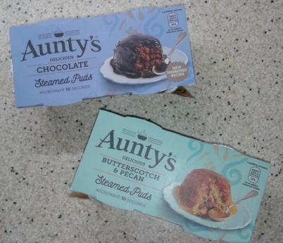
Alternatives: Killing mould on the surface
Heat treatment in the pack (e.g. Heinz sponge pudding in a can, Aunt Bessies and many others in a plastic pot, some Bagels and bread)
Issues – staling if eaten fresh
Surface sprays also work, as do UV and pulsed light (to some extent)

Slide 22
Alternatives: Slowing growth - different humectants
Name | Sucrose Equivalent
Glucose Syrup 42DE | 0.6
Sucrose | 1.0 (reference)
Lactose | 1.2
Dextrose | 1.3
Fructose | 1.4
Sorbitol | 2.0
Baking powder | 3.0
Glycerol/ine | 4.0
Salt | 11.0

Slide 23
Alternatives: Slowing growth - natural antimicrobial compounds
Sour dough cake – numerous natural antimicrobial compounds generated, mostly organic acids (ethanoic, propionic, sorbic...)
More acceptable to consumers / retailers than sorbate (no E-numbers)
Mould growth rates slowed
Favoured by low pH

Slide 24
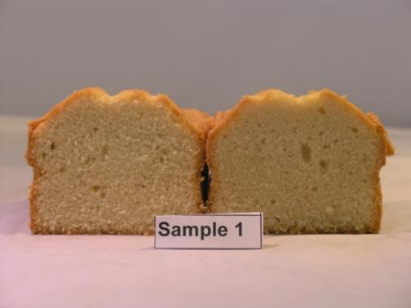
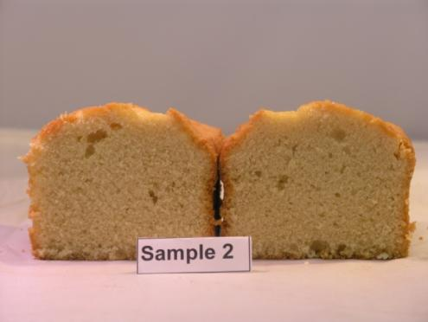
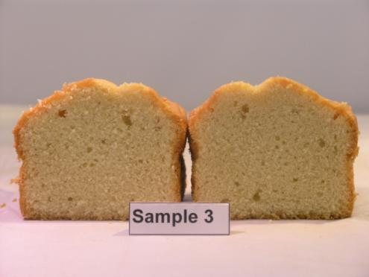
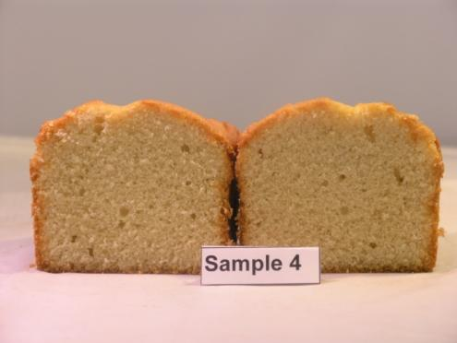
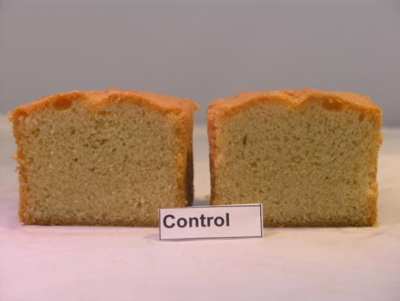
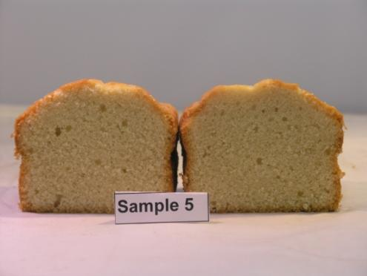
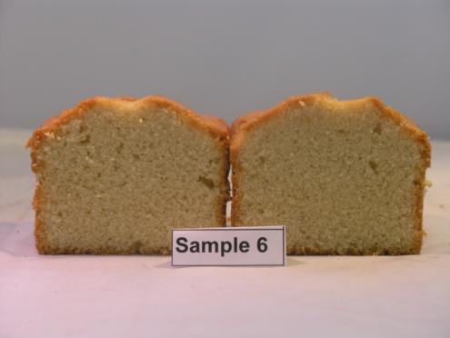
Sour dough cake
Sample | Details
1 | Flour and water, no ferment
2 | Added sour, no ferment
3 | Flour and water, 1hr ferment
4 | Added sour, 1hr ferment
5 | Flour and water, 2hr ferment
6 | Added sour, 2hr ferment
Control | Standard pound cake

Slide 25
Sample | Details | pH | a_{w} | MFSL
1 | Flour and water, no ferment | 8.05 | 0.86 | 23 days
2 | Added sour, no ferment | 7.40 | 0.86 | 23 days
3 | Flour and water, 1hr ferment | 7.98 | 0.87 | 23 days
4 | Added sour, 1hr ferment | 7.40 | 0.86 | 23 days
5 | Flour and water, 2hr ferment | 7.90 | 0.86 | 21 days
6 | Added sour, 2hr ferment | 7.34 | 0.87 | 26 days
Control | Standard pound cake | 8.05 | 0.83 | 31days (!)
Calculated MFSL about 10 days

Slide 26
MFSL commercial cakes
Product Description | a_{w} | pH | Preservative | MFSL (days)
Marble Cake | 0.728 | 7.35 | 0.19% P. Sorbate | 225
Orange and Raspberry Muffin | 0.673 | 6.04 | 0.20% P. Sorbate | 1205
Blueberry Muffin | 0.713 | 6.29 | 0.20% P. Sorbate | 643
Marble Brownie - Plain | 0.765 | 6.89 | 0.154% P. Sorbate + 0.174% C. Propionate | 101
Marble Brownie - Chocolate | 0.789 | 6.85 | 0.154% P. Sorbate + 0.174% C. Propionate | 63
Marble Cake | 0.798 | 7.57 | 0.10% P. Sorbate | 48
Trifle Sponge Cake | 0.806 | 7.64 | 0.205% P. Sorbate | 45
Christmas Cake | 0.811 | 6.22 | 0.04% P. Sorbate | 34
Banana and Walnut Muffin | 0.950 | 7.95 |  | 3
Chocolate and Date Muffin | 0.920 | 7.59 |  | 4
Christmas Cake | 0.787 | 5.39 | 0.10% P. Sorbate | 186
Fruit Cake | 0.741 | 5.00 |  | 84

Slide 27
Sour ferment cake thoughts
Sours and ferments lowered the pH due to acid production
Cakes with flour + water added or sour starter had lower shelf life due to the diluting effect on the sugar, hence higher a_{w}
Sour/fermentation times were not long enough to replace the antimicrobial effect of higher sugar content, although 2 hours ferment time had a positive effect
Shows potential - more work needed to reduce sugar and achieve MFSL

Slide 28
7. Role as texture softening agent
Sucrose binds water within its structure, keeping products soft over shelf life
Water is one of the best texture softening materials (fat and air are others)
Water and air are zero calorie – but water reduced MFSL

Slide 29
Disadvantages of sugar replacers
Sugar (sucrose) is clean label
Sugar has many functions so more than one material is required for its replacement (ingredient lists get longer)
Manufacturing cost increases
Product texture and flavour will be different
Calorie content can increase (fat proportion increases)
Inulin can ‘contain’ sugar as measured

Slide 30
The future?
Sugar debate has not finished yet
Some bakery products are high in sugar and are open to bad press
Efforts are needed to reformulate low sugar bakery products
Retailer cakes already contain high sugar levels (for MFSL) – sweetness is not the problem
MFSL is a major challenge - Sour starters and extended fermentation is an option to address MFSL

Slide 31
20% sugar reduction with retailer cakes
 | Sugars/100g | After 20% reduction
Party cake | 43.7 | 35.0
Chocolate cake | 38.3 | 30.6
Vanilla cake | 44.6 | 35.7
Angel cake | 34.6 | 27.7
Genoa | 42.5 | 34.0
Madeira | 34.2 | 27.4
Walnut | 33.9 | 27.1
Pound cake | 28.0 | -

Slide 32
An alternative future?
Cake has the potential to play a more important part in our diet
It can be much healthier – lower sugar, higher fibre and dietary benefits of extended fermentation
Cake does not require such high quality wheat as with bread – cheaper and more sustainable
Is there a need for heat treated flour?
What shelf life is required?

Slide 33
Date for your diaries:
4th International Bakery Technology Conference
23-24 May 2018
at Campden BRI
Gary.tucker@campdenbri.co.uk
www.campdenbri.co.uk

