Slide 1
How Morrisons Won the In Store Bakery Retailer of the Year.

Slide 2
Introduction
450 Scratch In Store Bakeries
374 dedicated Cake Shops.
1,200 trained Bakers.
Over 1,460 apprentices trained to NVQ Level 2 dough production & baking in the last 20 years.
Industrial plant bakery – Rathbones Wakefield.
Experienced team who are passionate about Bakery.

Slide 3
Not ‘how’ but ‘ why’ ............
Food Makers & Shopkeepers.
Morrisons Makes it and we make Morrisons.
We make and provide quality food that is affordable for our customers
Pride – every day
Passion
Listening hard & responding quickly wherever possible to customers , colleagues & suppliers.
Skill & Understanding
Customer , Colleague , Supplier – our key stakeholders.
This is how our passion comes alive.......our Easter Bakery story.

Slide 4
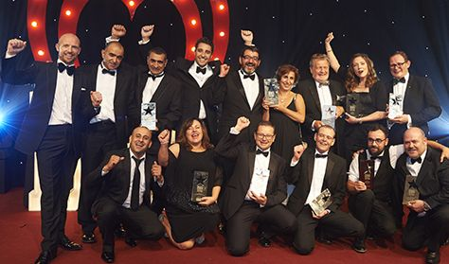
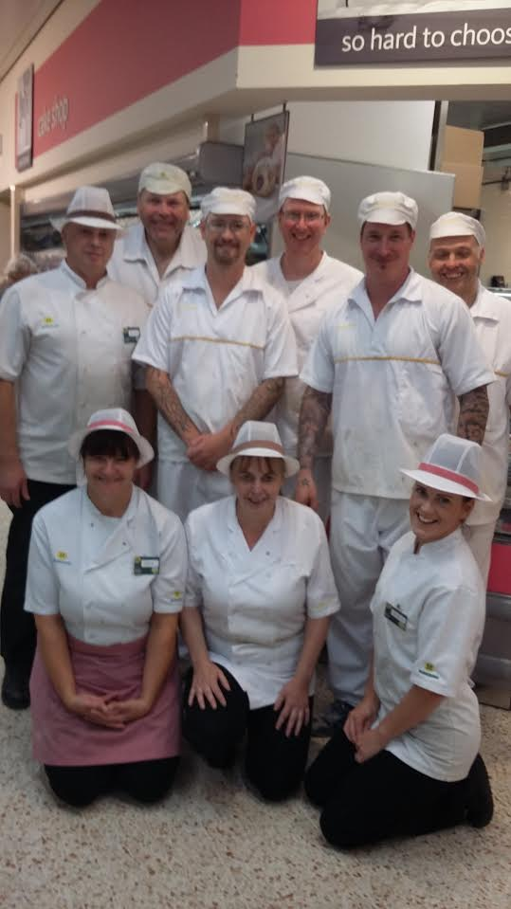
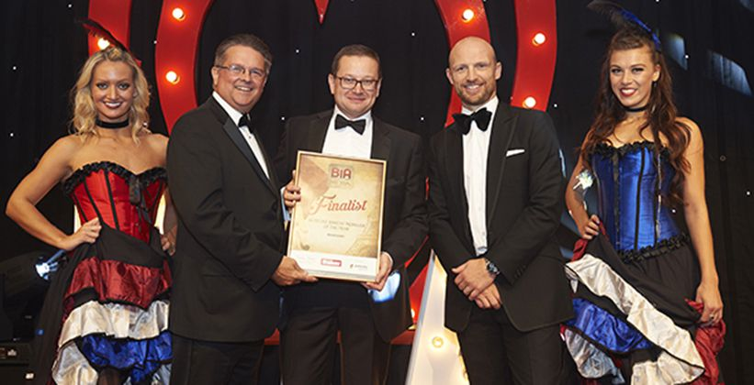
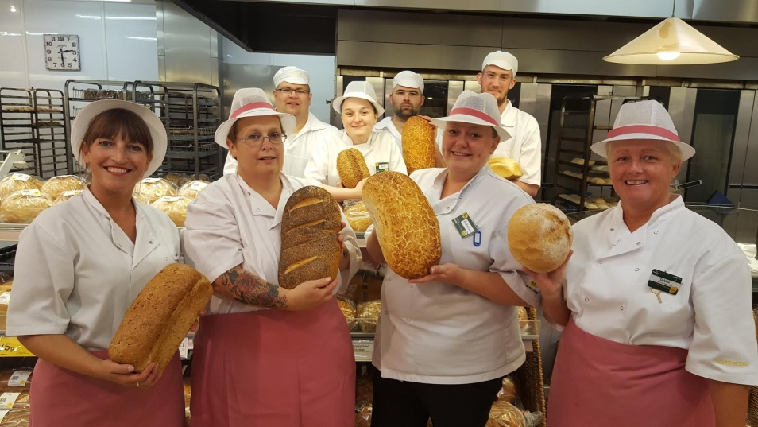
Morrisons - Proud winners of The In Store Bakery Retailer of the Year Award 2016

Slide 5
It’s a fantastic award to win!...... and we are proud to have won it
It’s a really thorough judging process.
The judges are Industry Experts.
We prepare a detailed Head Office Submission.
We host an escorted judges visit – last year it was Scarborough.
On top of that there are unannounced visits to nominated stores.
We have a winning track record having won in 2009,2011,2013 and 2016.
Awards are really important to the business and resonate with customers.
So we have been telling customers about our win.

Slide 6
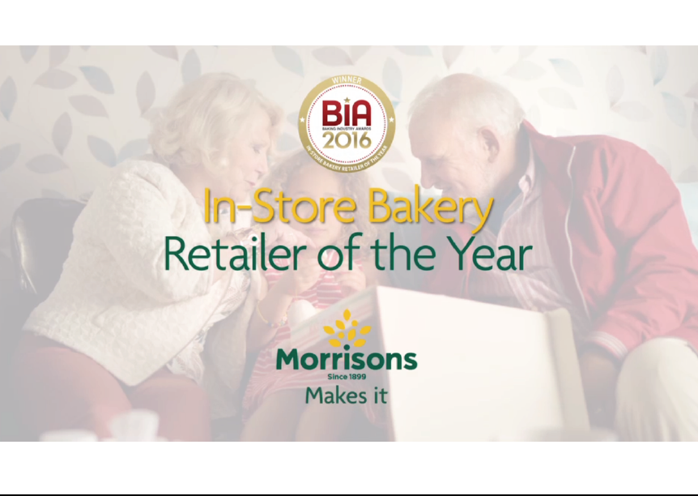
Bakery Industry Awards – Media Support – TV

Slide 7
Bakery Industry Awards – In Store Media Support
Front of Store Banner
Poster
Bakery Bulkhead
Shelf Barker

Slide 8
Bakery Industry Awards – Media Support – Press
FOS Banner

Slide 9
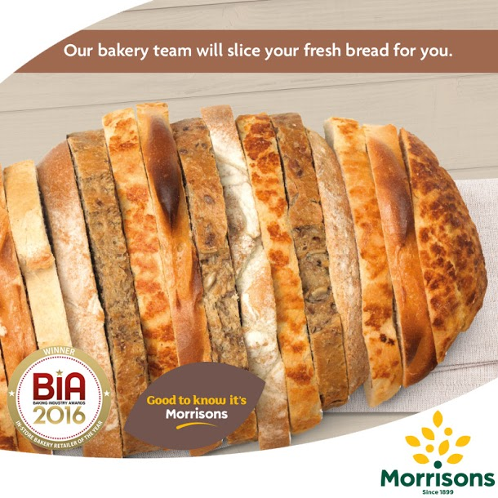
Bakery Industry Awards – Media Support – Digital
Likes – 3,346
Likes – 10,137

Slide 10
What made 2016 a winning year?
A cohesive , simple , corporate plan committed to making the core Supermarkets strong again.
The plan came alive in Bakery with Morrisons Makes it.
We listened to the previous years feedback and responded quickly.
We didn’t forget the importance of our unique patisserie operation.
We focused on the Importance of colleague engagement and training.
We maintained a supply base with long term relationships.

Slide 11
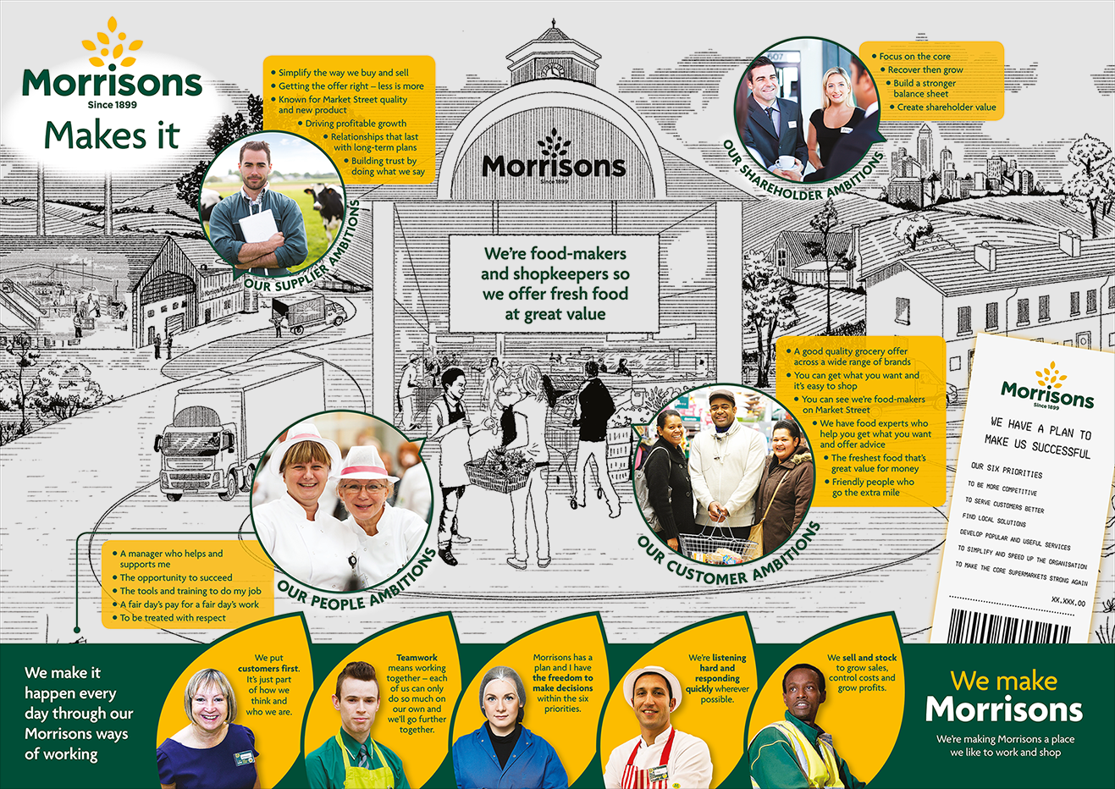
A simple cohesive plan from top floor to shop floor........

Slide 12
Morrisons Makes it – telling customers about our craft skills.
Focus on Craft skill - different to made by Morrisons
Hero lines – Doughnuts , Coburg Cob.
Scratch produced
Quality
Freshness – made that day.
Unique lines - Coburg , Foccaccia, Stollen, Panetonne,
Fruit tarts , Festival Gateau.

Slide 13
In Store Media covers Bakery, Cake Shop & Regional unique lines.

Slide 14
The importance of colleagues and training.
An Important factor in our win was the skill of our in store colleagues in delivering the strategy in store.
Over the last 20 years we have successfully trained in excess of 1460 bakers to NVQ Level 2 in dough production and baking and more recently the IPQ diploma.
Currently our apprentice bakers complete an IPQ to diploma level, which is set within the government approved apprentice framework. This means they do functional skills, employee rights and responsibilities, and personal learning and thinking skills.
The apprentices are taught all the skills regarding traditional baking. Dough production including fermentation & hand moulding.
Going forward our apprentices will take part in the new Government backed Trailblazer Apprenticeship scheme - Level 2 In store or Industrial, with a wider syllabus than before to include fried products and hand finishing of patisserie.
At present we currently have over 100 apprentices on the programme. 53 who are 75% through the course and 50 who started in September of last year.
The colleges presently in use are: Glasgow City College, Sheffield College and Barking & Dagenham College (London).
We run a Mastercraft competition every year.

Slide 15
Having Long term partnerships with suppliers is really Important to us

Slide 16
It is an important factor in being a food maker & shopkeeper.....
We value long term relationships.
Suppliers and supplier relationships are one of our 4 ambitions.
We are a volume driven business.
We listen to our suppliers.
We help each other.
We have tough discussions at times but trade with honesty, integrity and respect.
We value true innovation,unique products and newness.

Slide 17
How can Suppliers help us to improve our offer going forward?
Quality.
Consistency.
Value.
Newness.
Innovation , quirky not gimmicky - exclusive to Morrisons
Great service – technical , sales , logistics , accounts,

Slide 18
Thank you

